Slide 1
Jenkins Master And Slave Architecture
Sachin Chandiwade

Slide 2
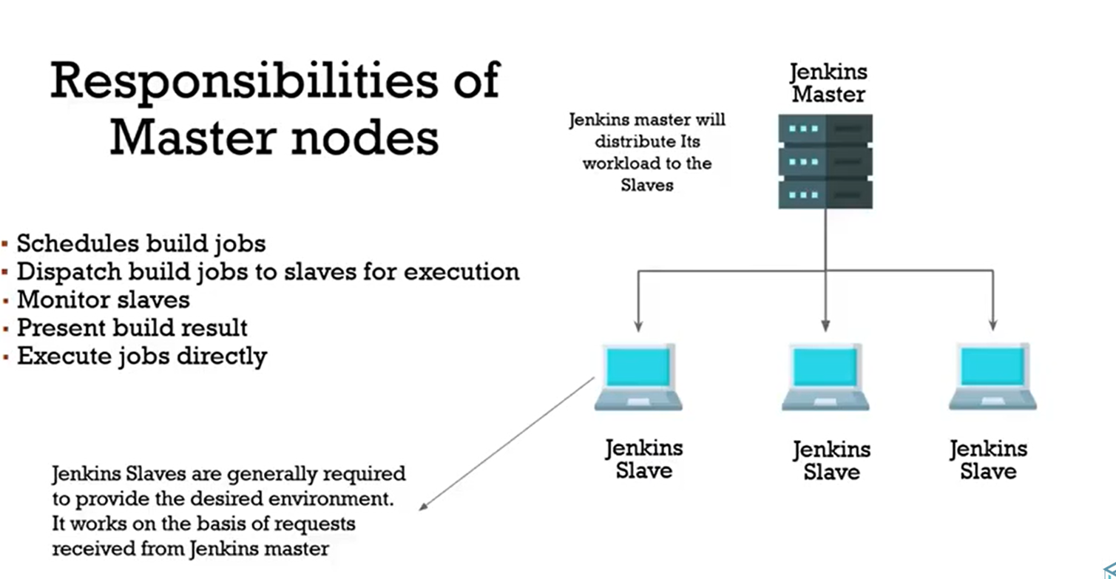

Slide 3
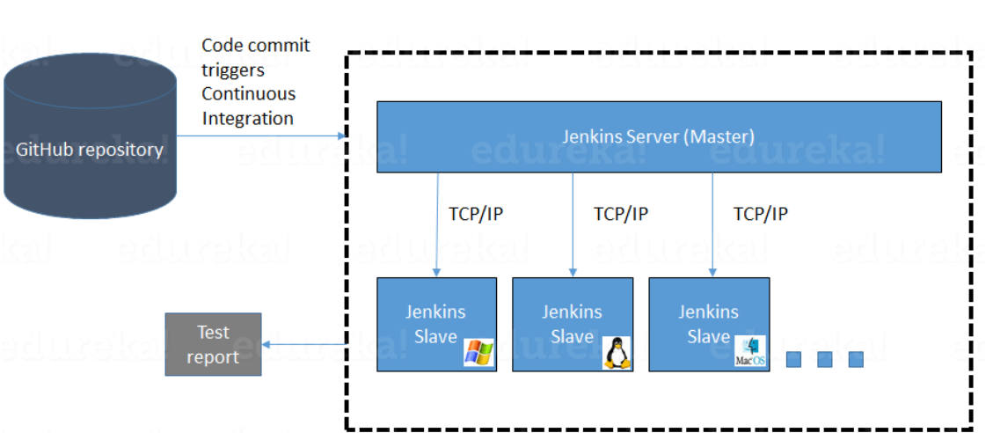

Slide 4
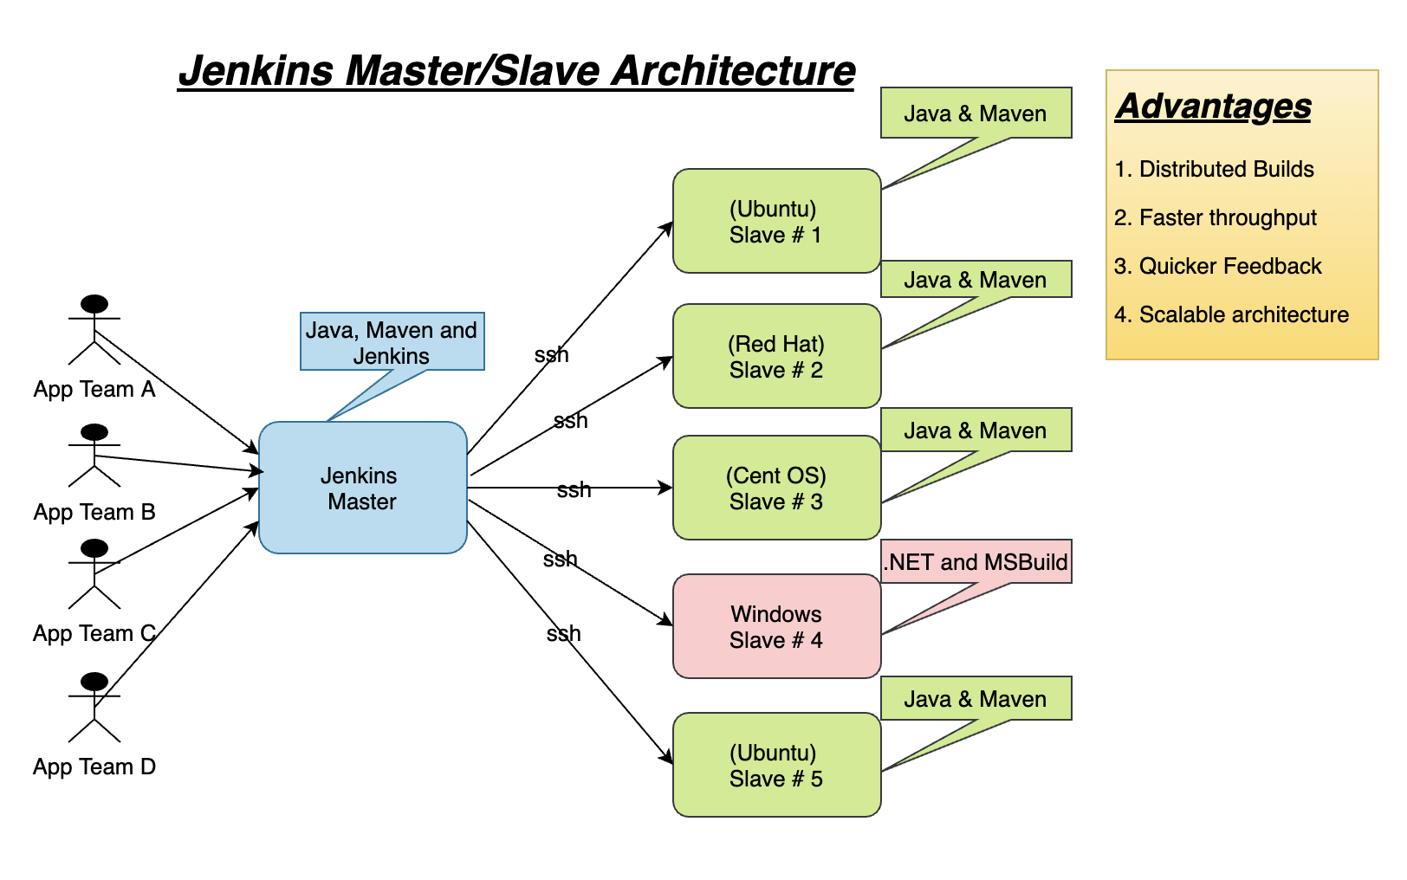

Slide 5
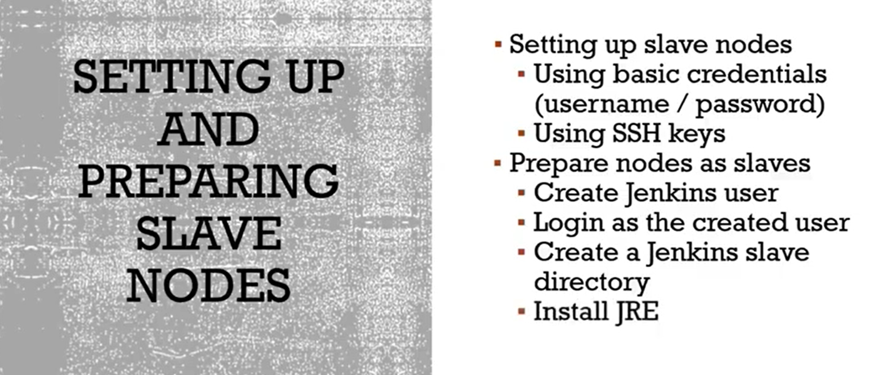

Slide 6
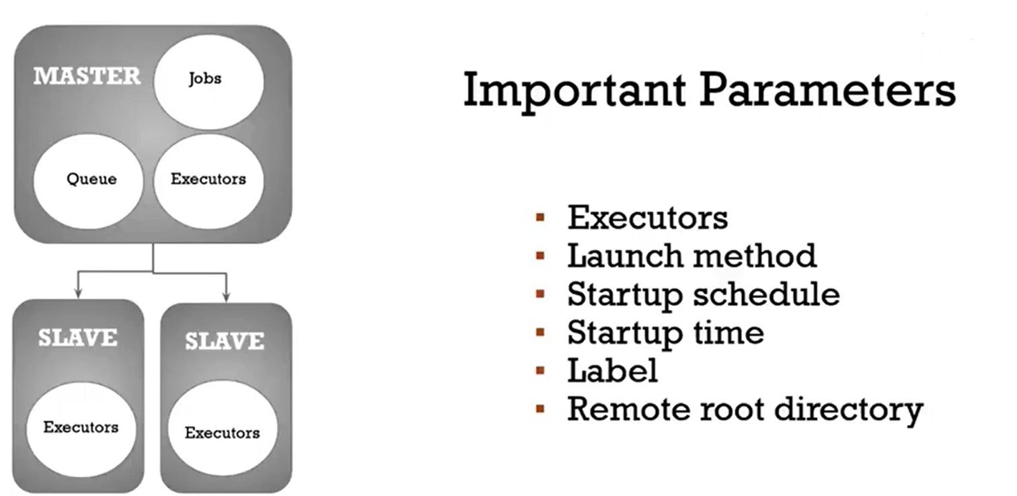

Slide 7
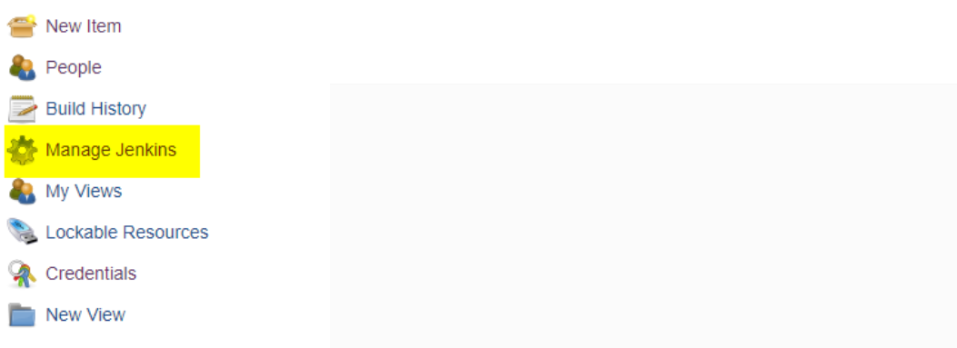
How to setup Jenkins Master and Slaves 1.Go to the Manage Jenkins section and scroll down to the section of Manage Nodes.

Slide 8
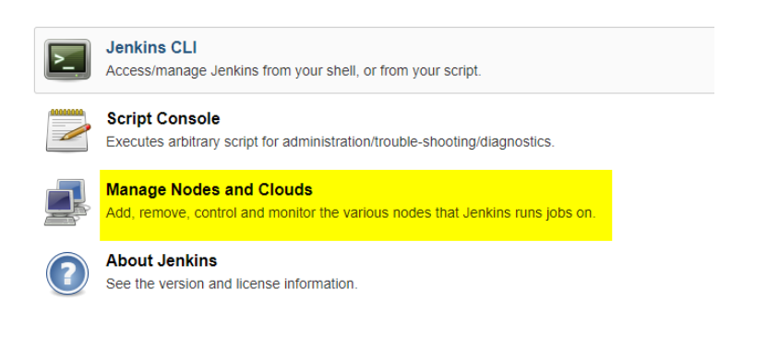

Slide 9
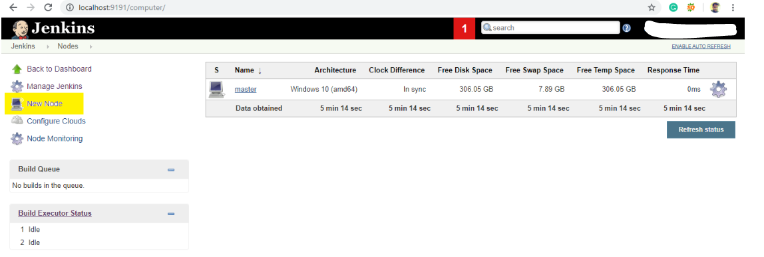
2. Click on New Node

Slide 10
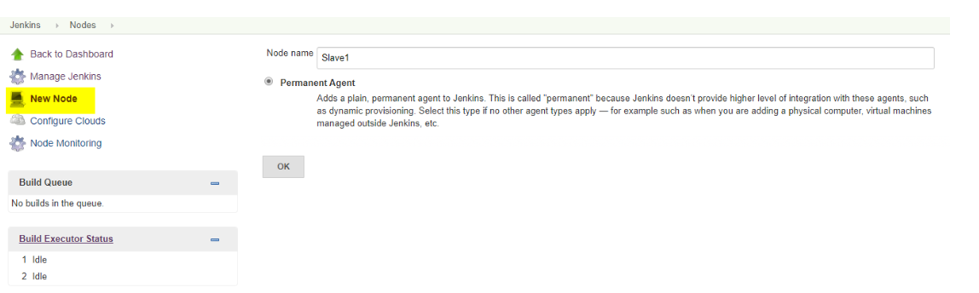
3. Give a name for the node, choose the Permanent Agent option and click on Ok.

Slide 11
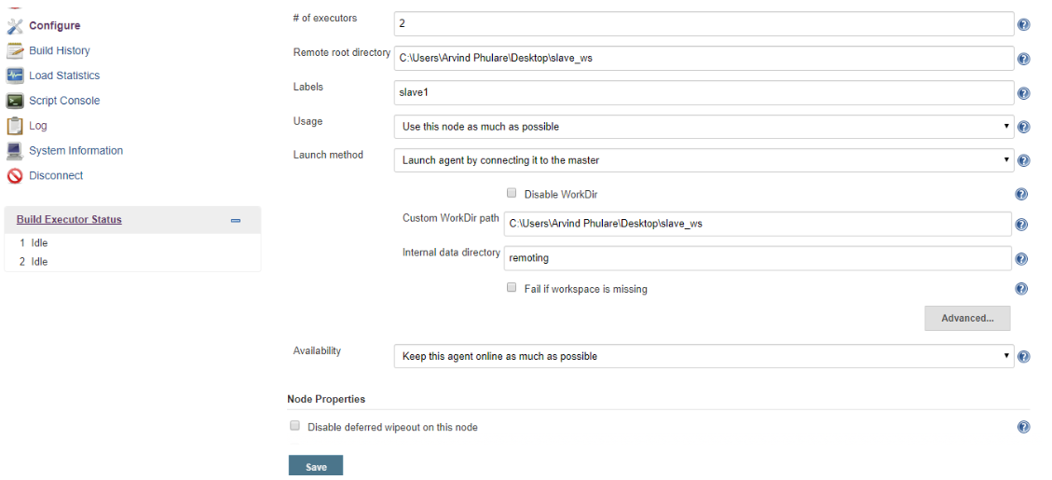
4. Enter the details of the node slave machine. Here no. of executers in nothing but no. of jobs that this slave can run parallely. Here we have kept it to 2. The Labels for which the name is entered as “Slave1” is what can be used to configure jobs to use this slave machine.Select Usage to Use this node as much as possible. For launch method we select the option of “Launch agent by connecting it to the master”. If this option is not visible then go to Jenkins home page -> Manage Jenkins -> Configure Global Security. Here in the Agents section click on Random and Save it. Now you will find the required option. Enter Custom WorkDir path as the workspace of your slave node. In Availability select “Keep this agent online as much as possible”.Click on Save.

Slide 12
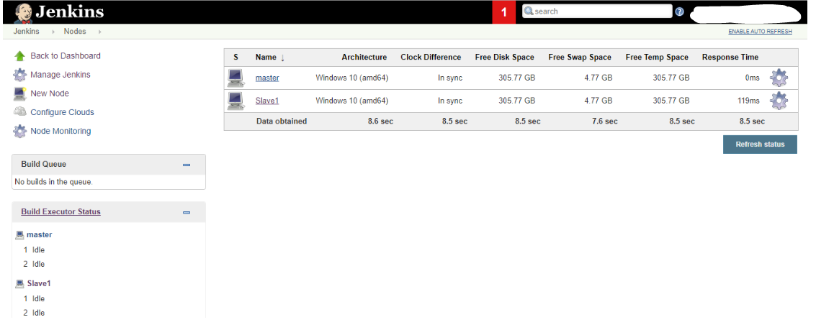
Once you complete the above steps, the new node machine will initially be in an offline state but will come online if all the settings in the previous screen were entered correctly. One can at any time make the node slave machine offline if required.

Slide 13
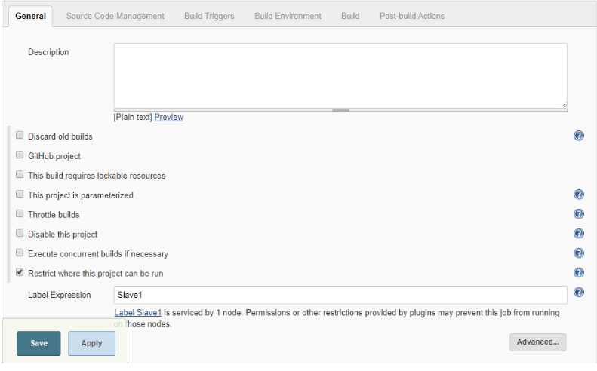
5. Now since your slave is up and running, lets execute a job on slave. For that I already have an existing job and I will run this job on this slave. Open this job and click on configure. Now here in the General section, click on “Restrict where this project can be run”. Here in Label Expression, enter the name of the slave and save it. Now click on Build now and see the output of this job. Everything is correct you will see the output as Success.

